Slide 1

Home Network and Heatmap
Mikayla Hawley

Slide 2

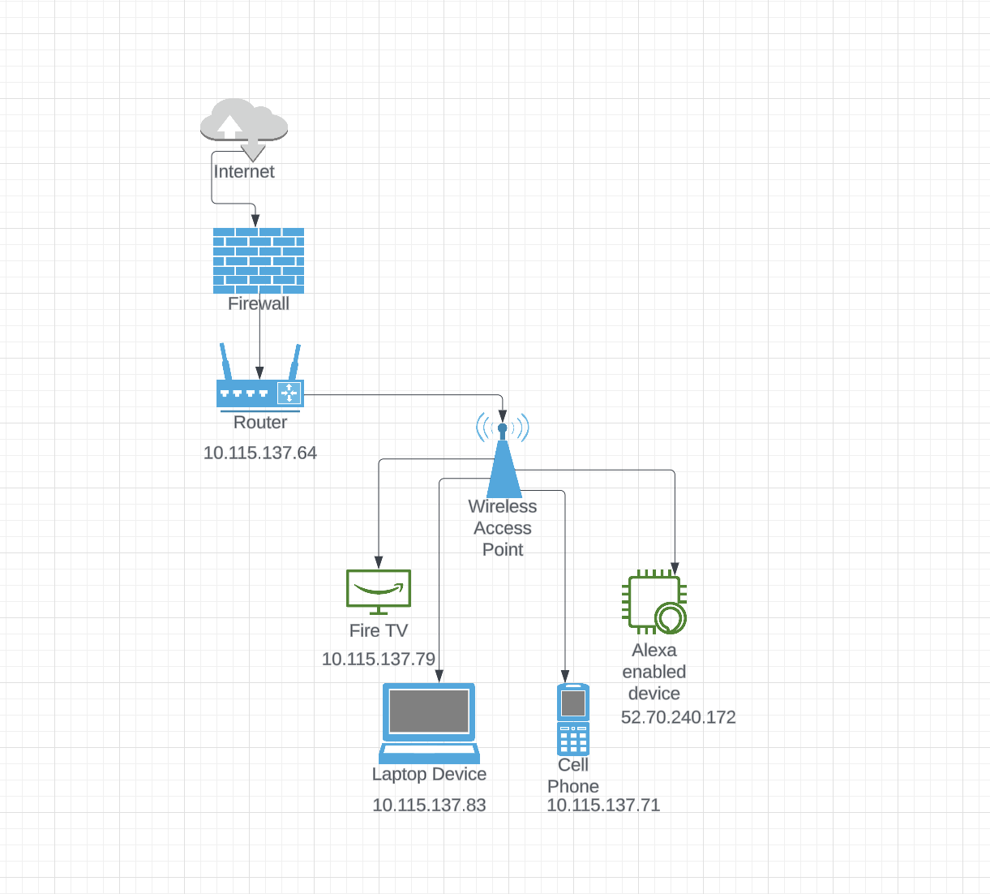



Network Layout

Slide 3

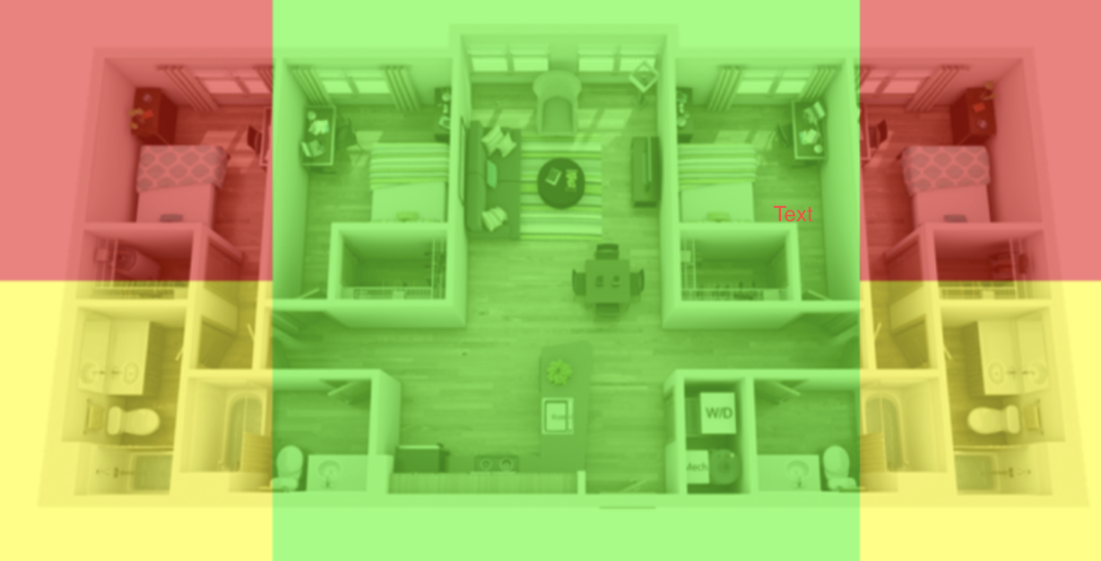
Heat Map
Attached is a picture of the 4-bedroom 4-bathroom layout from the Boundary’s website
The router is on the ceiling in the middle of the living room and kitchen area, due to this it has the strongest connection
The rooms and bathroom closest to the living and kitchen space get a good connection
The outer two rooms are tucked away in the back corner with their bathroom space getting a slightly better connection
I demonstrate how the other rooms and areas are affected based on the heatmap

